Slide 1



Slide 2
Timeline Overview
Modern Mapping
Terravision
Keyhole
Google Earth
Launched in 1993, Terravision introduced innovative 3D visualization of Earth’s surface.
Keyhole, established in 1999, enhanced satellite imagery for dynamic mapping experiences.
Google Earth, released in 2005, revolutionized geospatial technology with user-friendly navigation.
The evolution of digital mapping continues to shape our understanding of geography.

Slide 3
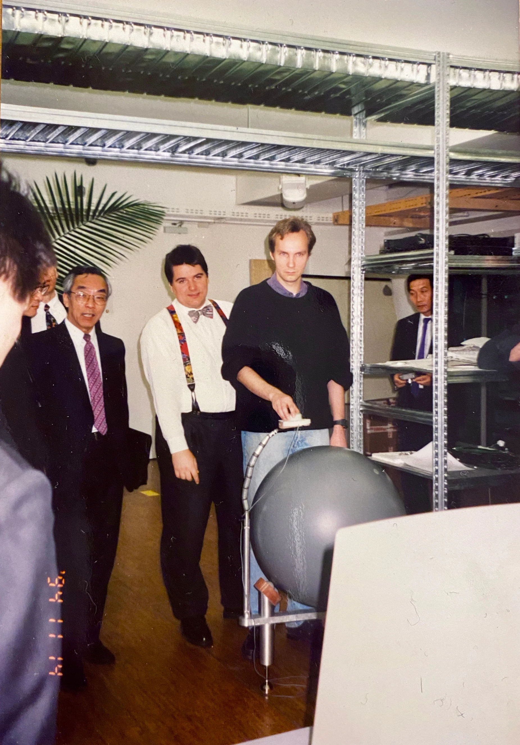
Terravision Breakdown

Slide 4


Slide 5
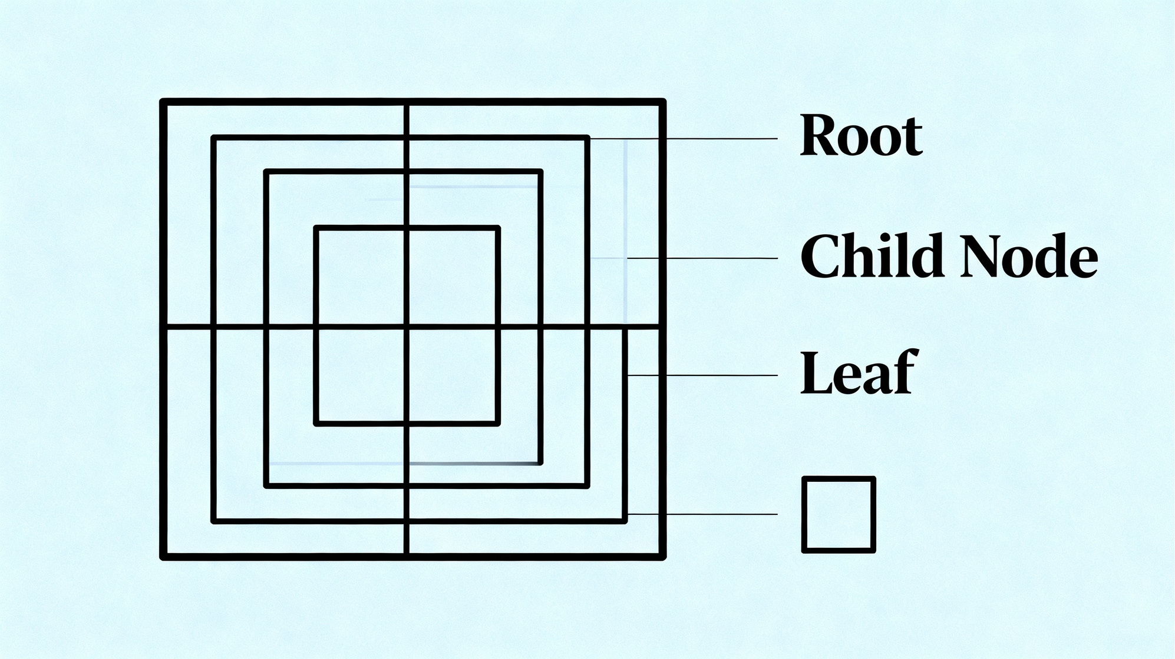

Slide 6

3D Rendering

Slide 7
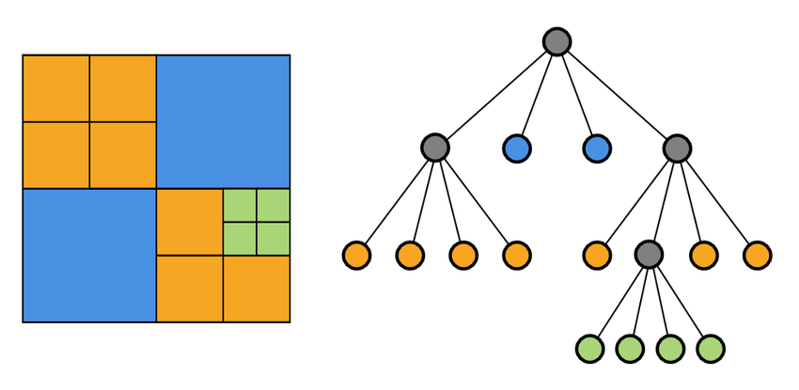
hierarchical quad-Tree data structure

Slide 8
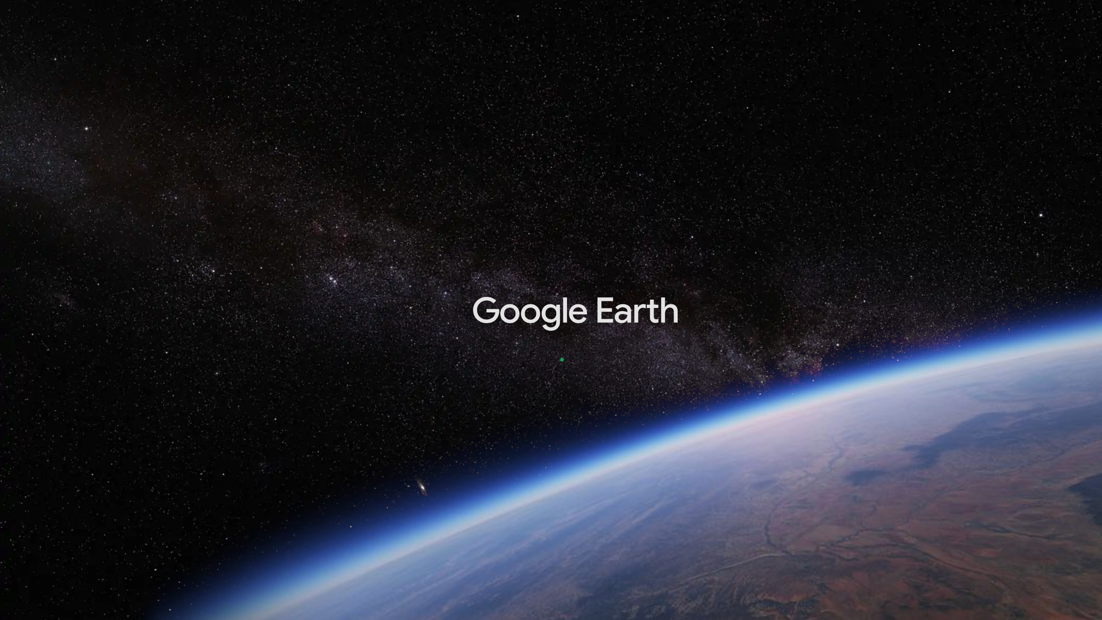

Slide 10
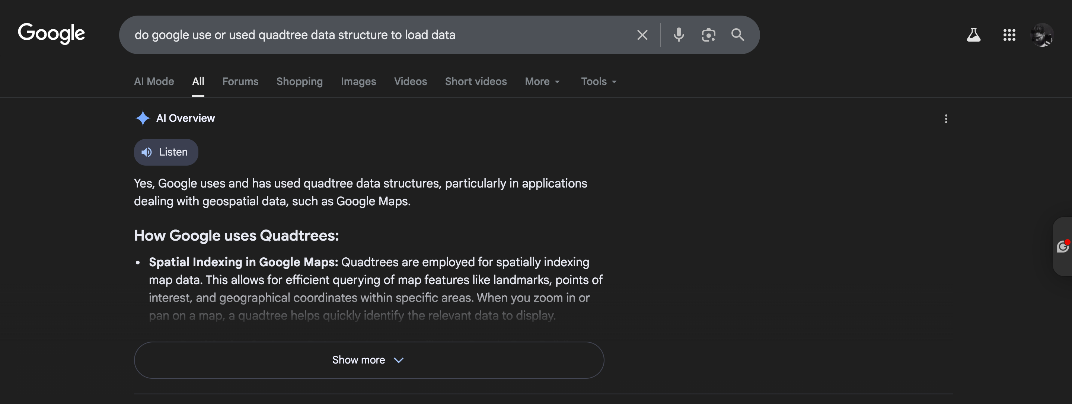

Slide 11
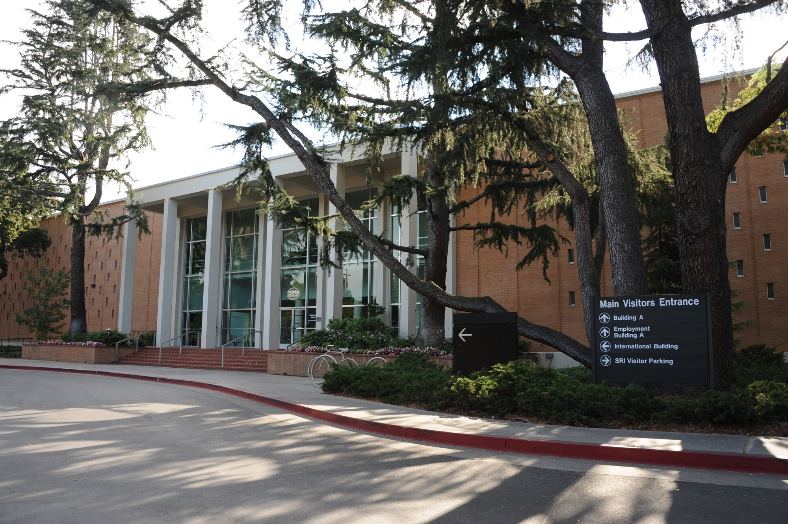

Slide 12

Legal Conflict

Slide 13
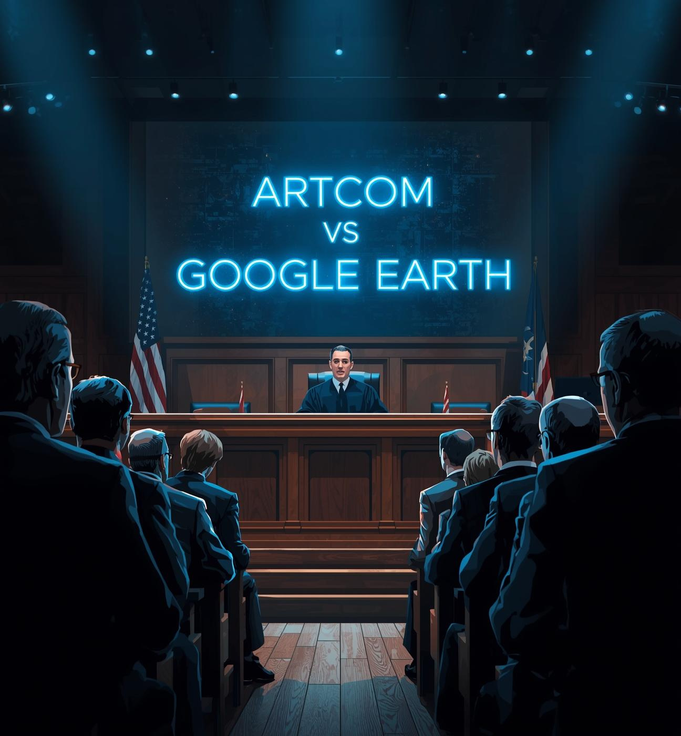
Patent Claims
The legal dispute revolves around the allegations that Google Earth infringed on Terravision's innovative technology. The courtroom is abuzz with tension as attorneys present their case, emphasizing the significance of intellectual property rights amidst rapid technological advancements in digital earth visualization.

Slide 14
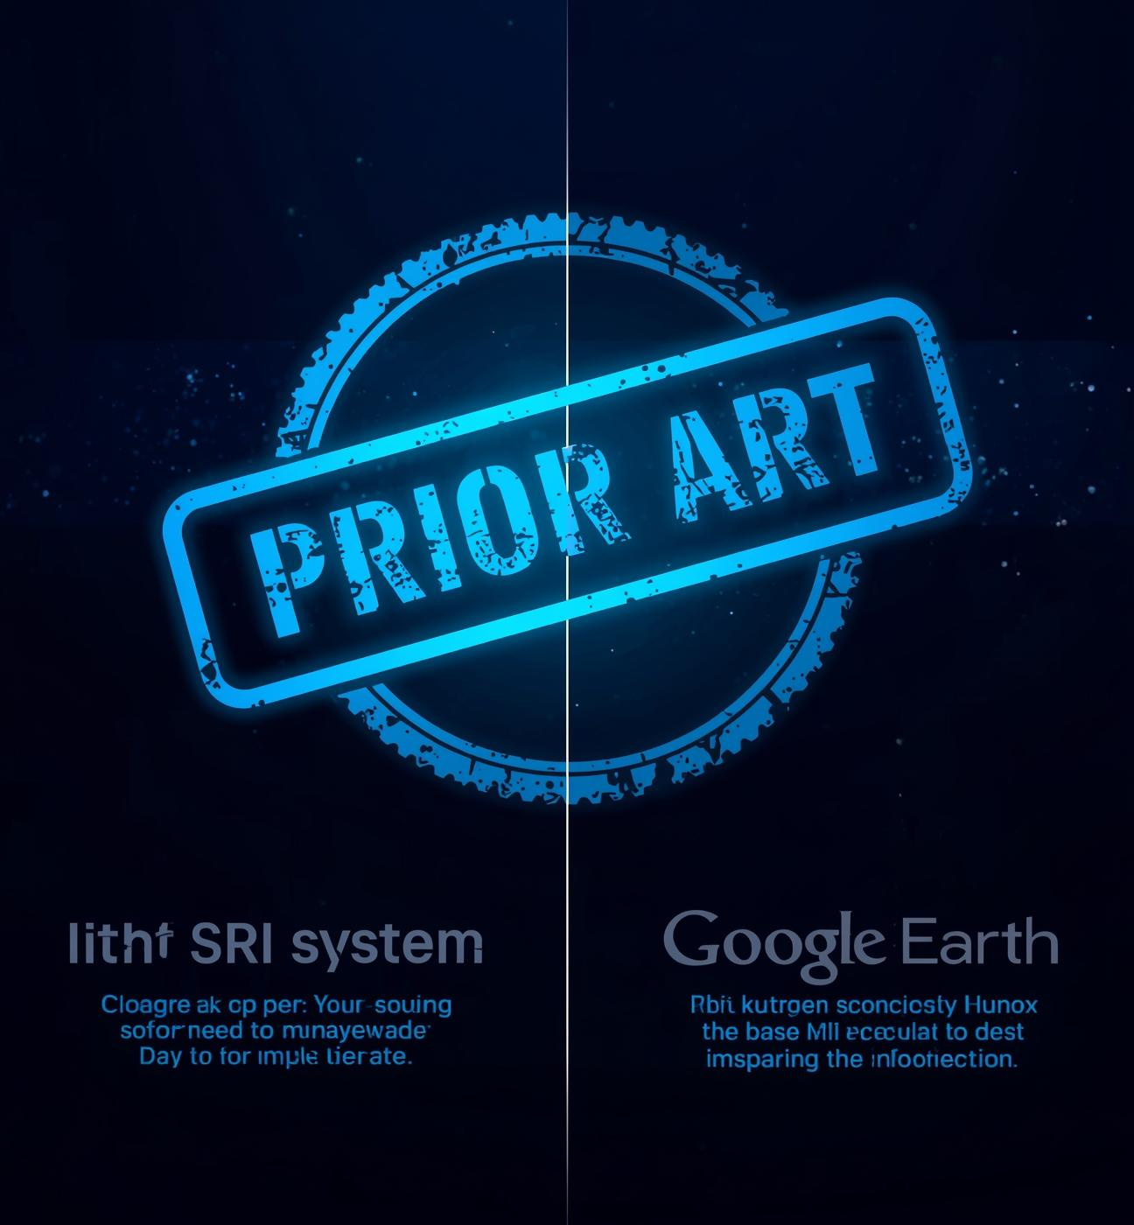
Prior Art
This section highlights Google's defense in the legal conflict over digital Earth technologies. The concept of prior art asserts that existing innovations, like the SRI system, predated Google's developments, emphasizing the importance of understanding historical context in intellectual property disputes.

Slide 15

GET IN TOUCH
https://github.com/Sam-bot-dev
Embrace the Future

Slide 16
“Two German pioneers dared to imagine the world from above long before the world was ready. Vision doesn’t always win in court, but it never dies in history.”

